Slide 1
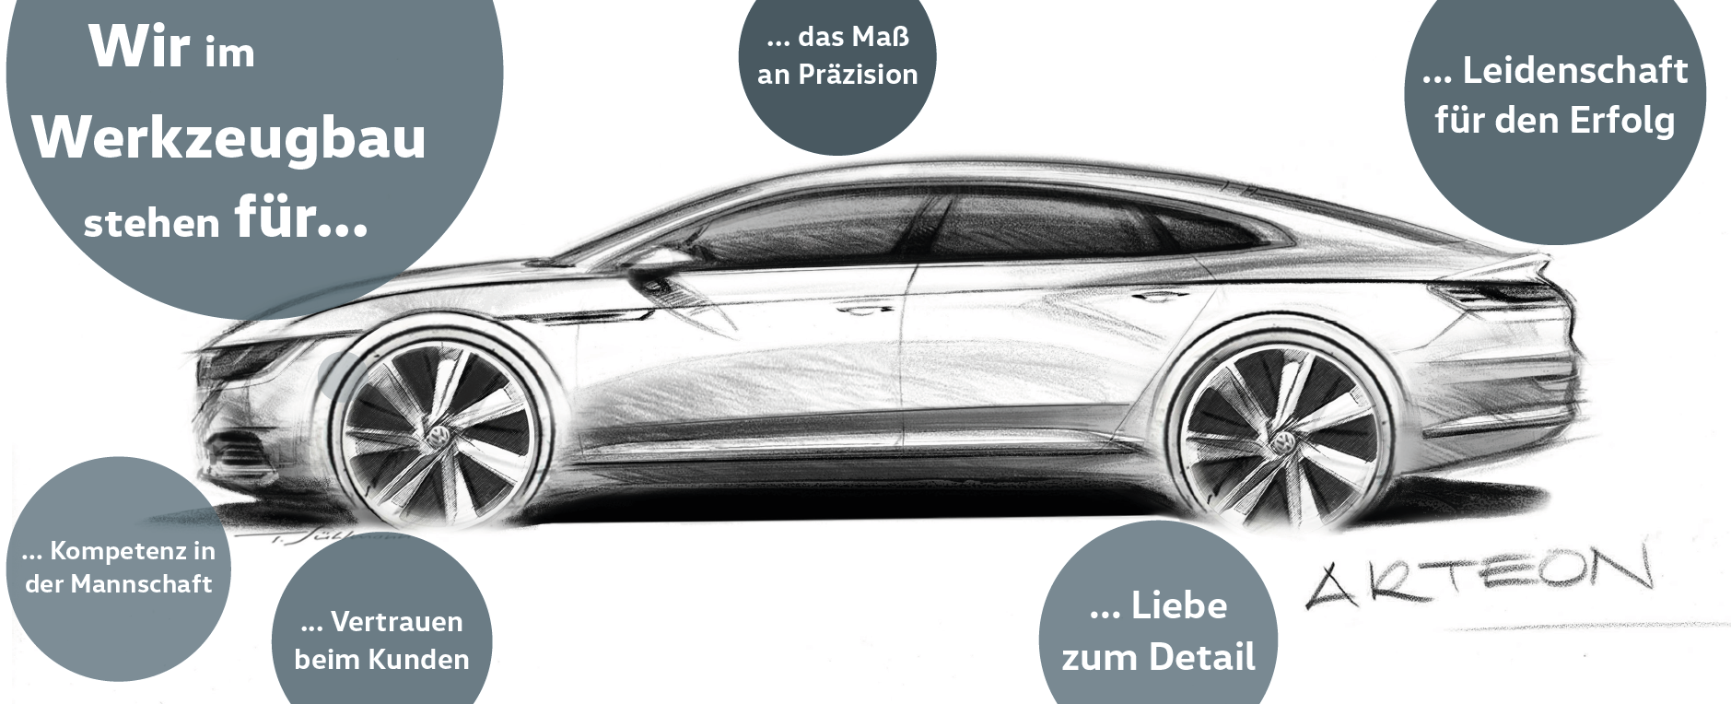


Werkzeugbau Marke Volkswagen
walk man

Slide 2
Inhalt
1 Europe
2 Asia
3 Afria
4 Oceania

Slide 5
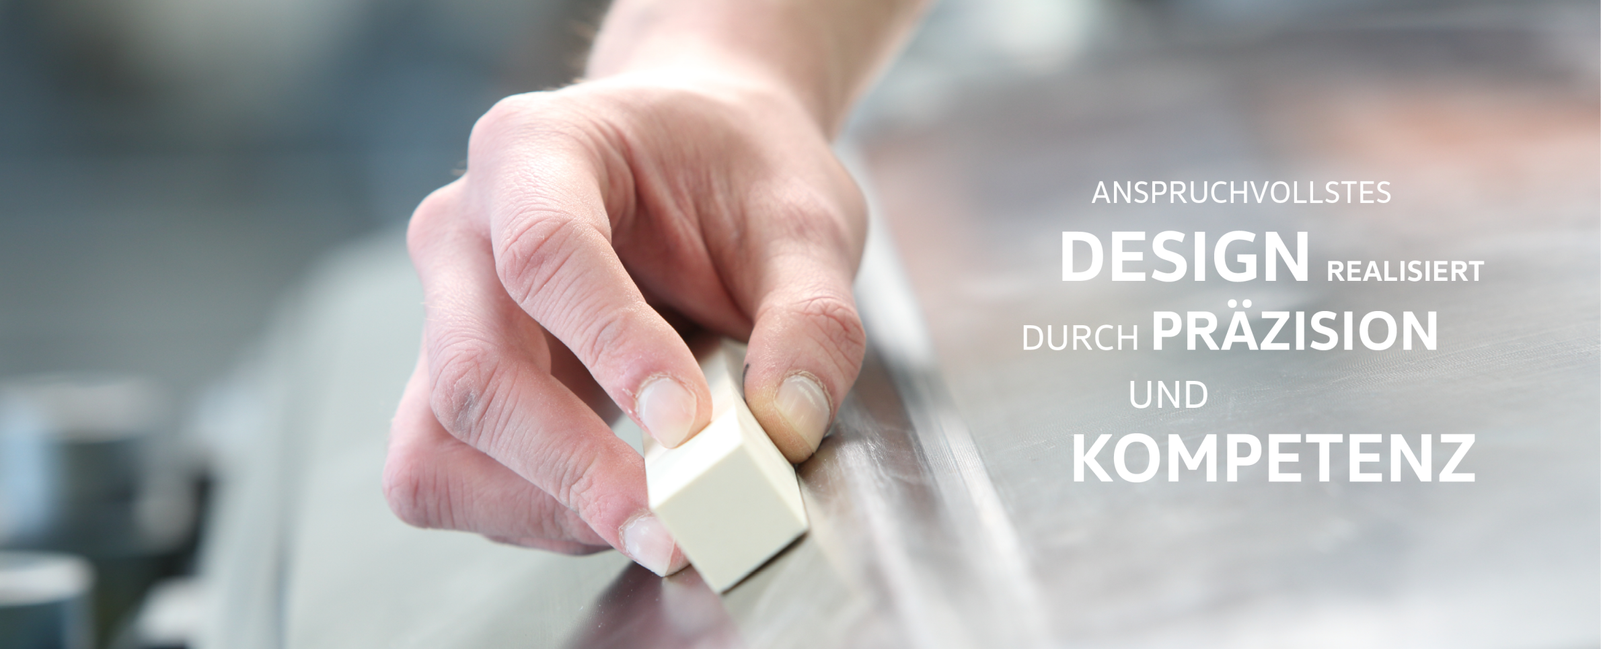
1. Europe

Slide 6
Inhalt
1. Europe
1.1 Finnland
1.2 French
1.3 England
1.4 German

Slide 7
1.1 Finnland
1.1.1 Kajaani
1.1.2 Imatra
1.1.3 Hanko
1.1.4 Ikaalinen

Slide 9
1.2 French
1.2.1 Paris
1.2.2 Marseille
1.2.3 Toulouse
1.2.4 Nantes

Slide 11
1.3 England
1.3.1 Birmingham
1.3.2 Cambridge
1.3.3 Coventry
1.3.4 Hereford

Slide 13
1.4 German
1.4.1 Berlin
1.4.2 Hamburg
1.4.3 Dortmund
1.4.4 Bremen

Slide 15
2. Asia

Slide 16
Inhalt
2. Asia
2.1 China
2.2 Japanese
2.3 Tailand
2.4 Malaysia

Slide 17
2.1 China
2.1.1 Guangzhou
2.1.2 Dalian
2.1.3 Shenzhen
2.1.4 Beijing

Slide 19
2.2 Japanese
2.2.1 Tokyo
2.2.2 Nagoya
2.2.3 Kawasaki
2.2.4 Sapporo

Slide 21
2.3 Tailand
2.3.1 Bangkok
2.3.2 Pattaya
2.3.3 Chonburi
2.3.4 Lampang

Slide 23
2.4 Malaysia
2.4.1 Ipoh
2.4.2 Kuala
2.4.3 Johor
2.4.4 Kuching

Slide 25
3. Afria

Slide 26
Inhalt
3. Afria
3.1 Zambia
3.2 Zimbabwe
3.3 Namibia
3.4 Comoros

Slide 27
3.1 Zambia
3.1.1 Lusaka
3.1.2 Ndola
3.1.3 Kitwe
3.1.4 Kabwe

Slide 29
3.2 Zimbabwe
3.2.1 Harare
3.2.2 Bulawayo
3.2.3 Chitungwiza
3.2.4 Mutare

Slide 31
3.3 Namibia
3.3.1 Opuwo
3.3.2 Eenhana
3.3.3 Gobabis
3.3.4 Outapi

Slide 33
3.4 Comoros
3.4.1 Moroni
3.4.2 Fomboni
3.4.3 Dzaoudzi
3.4.4 Mayotte

Slide 35
4. Oceania

Slide 36
Inhalt
4. Oceania
4.1 Australia
4.2 New Zealand
4.3 Nauru
4.4 Tuvalu

Slide 37
4.1 Australia
4.1.1 Sydney
4.1.2 Melbourne
4.1.3 Brisbane
4.1.4 Perth

Slide 39
4.2 New Zealand
4.2.1 Auckland
4.2.2 Wellington
4.2.3 Christchurch
4.2.4 Hamilton

Slide 41
4.3 Nauru
4.3.1 Aiwo
4.3.2 Ewa
4.3.3 Yaren
4.3.4 Ijuw

Slide 43
4.4 Tuvalu
4.4.1 Nui
4.4.2 Nukufetau
4.4.3 Vaitupu
4.4.4 Niutao

